Slide 1
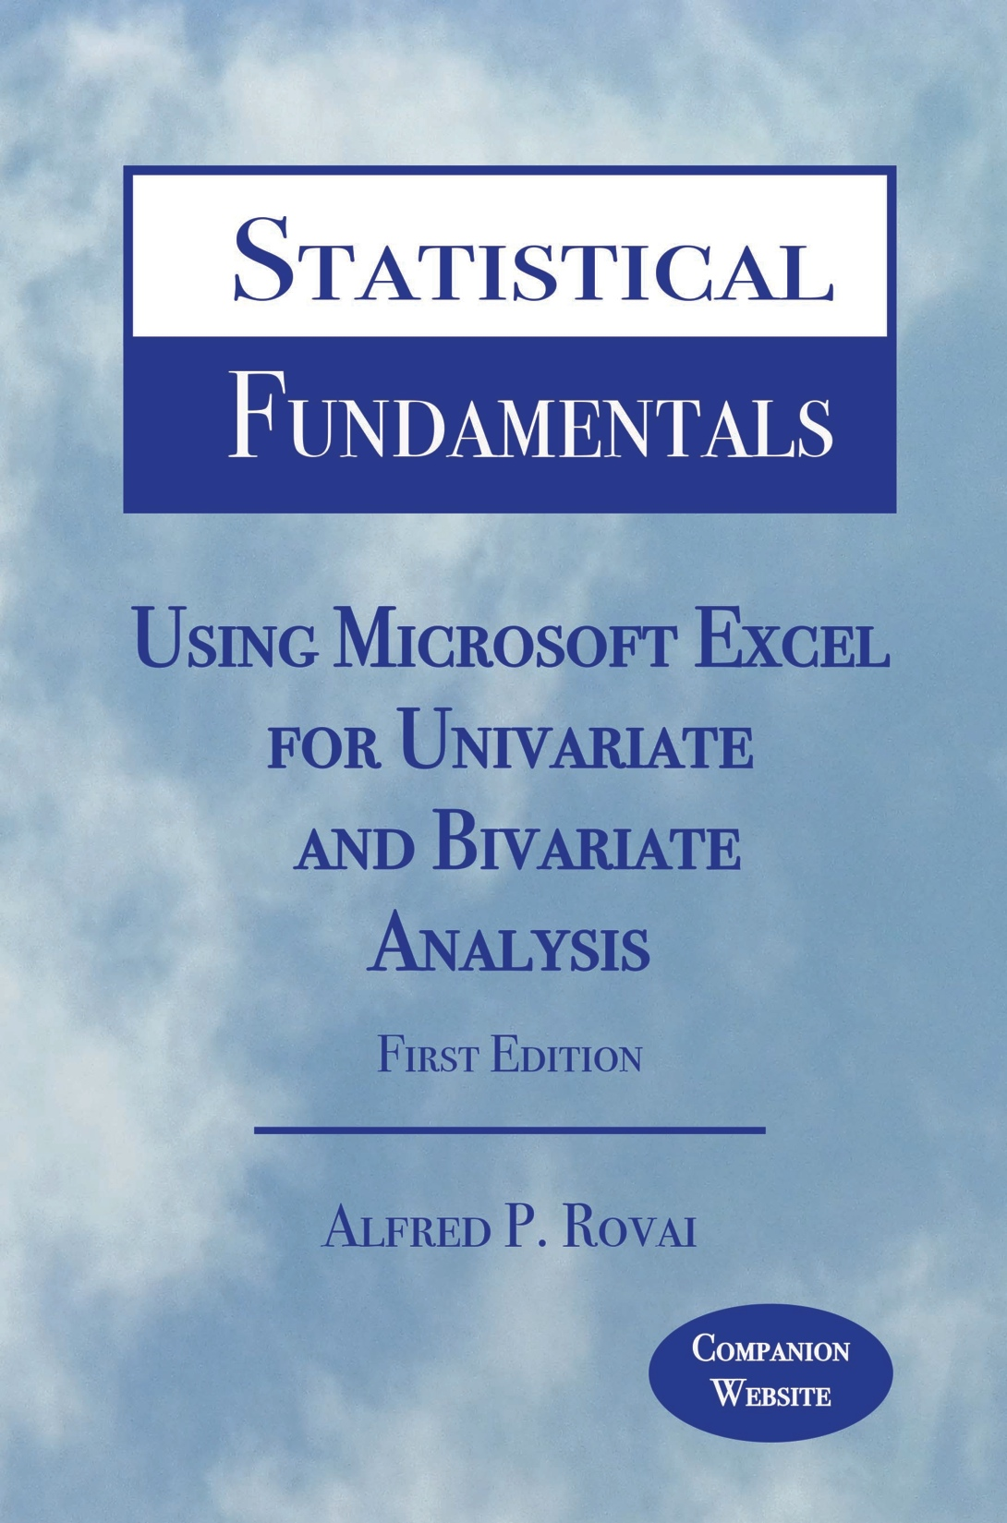
Statistical Fundamentals:
Using Microsoft Excel for Univariate and Bivariate Analysis
Alfred P. Rovai
Descriptive Statistics
PowerPoint Prepared by
Alfred P. Rovai
Microsoft® Excel® Screen Prints Courtesy of Microsoft Corporation.

Slide 2
Descriptive Statistics
Statistics
  Summary measures calculated for a sample dataset.
Parameters
  Summary measures calculated for a population dataset.
Used to describe the characteristics of frequency distributions
  Measures of central tendency, e.g., mean, median, mode
  Measures of dispersion, e.g., standard deviation, variance, range
  Measures of relative position, e.g., percentile, quartiles
  Graphs and charts, e.g., scatterplots, column charts, histograms

Slide 3
Measures of Central Tendency
Designed to give information concerning the typical score of a large number of scores.
Researchers typically report the best measures of central tendency and dispersion for each variable. The best measure to report varies based on the shape of a variable’s distribution and scale of measurement.
  Interval/ratio data – mean, median, and mode can be calculated and reported, as appropriate.
  Ordinal data - median can and should be reported; use of the mean is wrong.
  Nominal data - mode can and should be reported; use of either mean or median is wrong.
 | Appropriate Measures of Central Tendency
Nominal data | Mode
Ordinal data | Median, Mode
Interval data | Mean, Median, Mode
Ratio data | Mean, Median, Mode

Slide 4
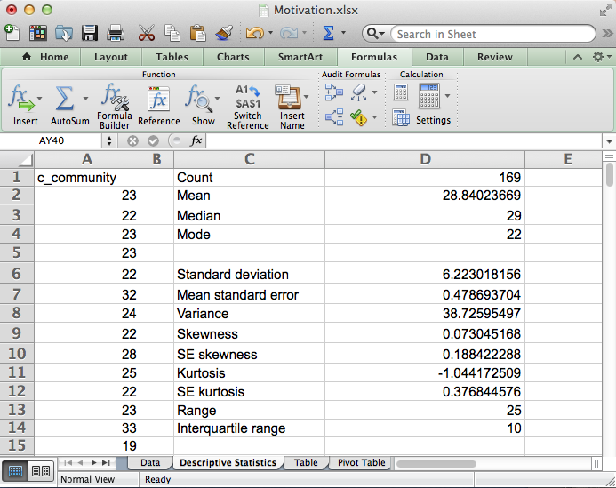
Open the dataset Motivation.xlsx.
Click the worksheet Descriptive Statistics tab (at the bottom of the worksheet).
File available at http://www.watertreepress.com/stats
TASK
Calculate the count, mean, median, and mode of the classroom community (c_community) variable.

Slide 5
Count (Sample Size; N or n)
The count (N, n) is a statistic that reflects the number of cases selected in the dataset. It is often used to represent sample (N) or sub-sample (n) size. It is an important statistic in any research study.
Excel functions:
COUNT(value1,value2,...). Counts the numbers in the range of numbers.
COUNTA(value1,value2,...). Counts the cells with non-empty values in the range of values.

Slide 6
Example of Count
N = 9

Slide 7
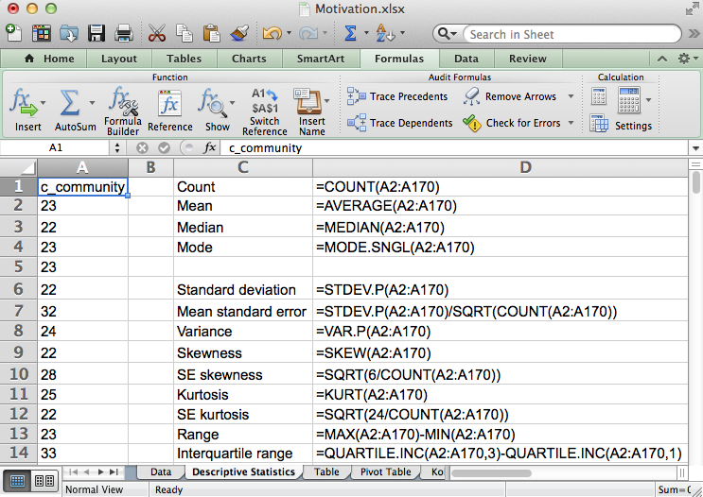
TASK
Enter the following formula in cell D1 to calculate the sample size used to measure c_community:
=COUNT(A2:A170)

Slide 8
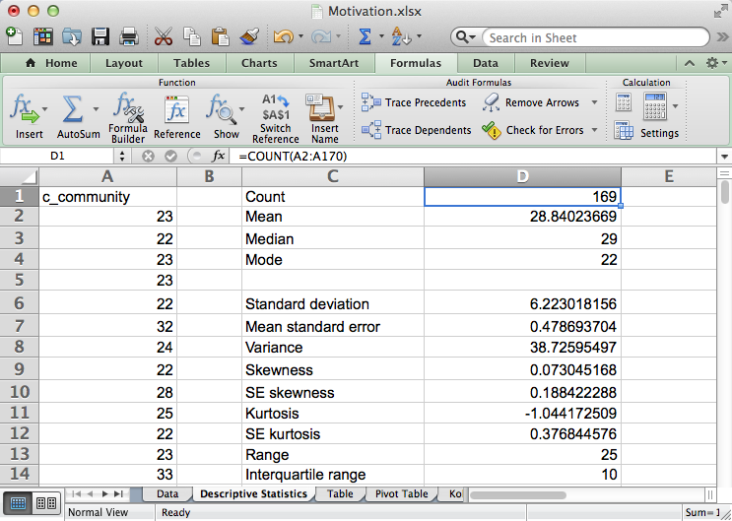
Excel displays the count as 169. This sample statistic is typically reported as N = 169 in the results section of a research paper, as appropriate.

Slide 9
Mean (Arithmetic Average; M ,µ)
Determines the sample mean or estimating an unknown population mean.
  Population mean is denoted by the Greek letter μ (mu)
  Sample mean is denoted by M or x-bar.
Used with interval and ratio scales
Best measure to describe normal unimodal distributions. Unlike the median and the mode, it is not appropriate to use the mean only to describe a highly skewed distribution.
Always located toward the skewed (tail) end of skewed distributions in relation to the median and mode.
Formulas
Excel function:
AVERAGE(number1,number2,...). Returns the arithmetic mean, where numbers represent the range of numbers.

Slide 10
Example of Mean
Mean = 6.33
Sum of deviations from the mean = 0

Slide 11
TASK
Enter the following formula in cell D2 to calculate the mean of variable c_community:
=AVERAGE(A2:A170)

Slide 12
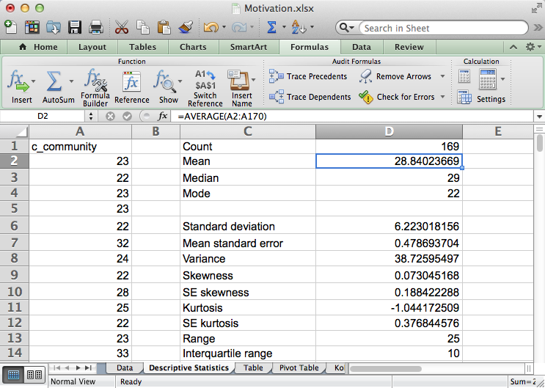
Excel displays the mean as 28.84. This sample statistic is typically reported as M = 28.84 in the results section of a research paper, as appropriate.

Slide 13
Median (Mdn)
The median is the score that divides the distribution into two equal halves (score at the 50th percentile).
  It is the midpoint of the distribution when the distribution has an odd number of scores.
  It is the number halfway between the two middle scores when the distribution has an even number of scores.
Not sensitive to outliers.
Used with the ordinal scale or when the distribution is skewed
If the distribution is normally distributed (i.e, symmetrical and unimodal), the mode, median, and mean coincide.
Excel function:
MEDIAN(number1,number2,...). Returns the median of a range of numbers.

Slide 14
Example of Median
Median = 7
The median is the mid value of ranked data when there are an odd number of cases

Slide 15
TASK
Enter the following formula in cell D3 to calculate the median of variable c_community:
=MEDIAN(A2:A170)

Slide 16
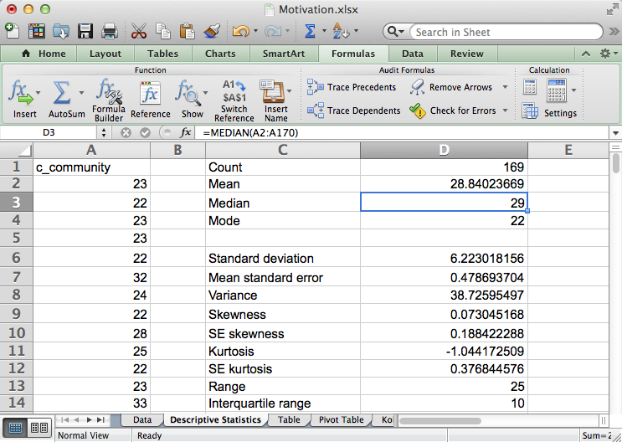
Excel displays the median as 29.

Slide 17
Mode (Mo)
Most frequently occurring score
A distribution is called unimodal if there is only one major peak in the distribution of scores when displayed as a histogram
If the distribution is normally distributed (i.e, symmetrical and unimodal), the mode, median, and mean coincide
The mode is useful in describing nominal variables and in describing a bimodal or multimodal distribution (use of the mean or median only can be misleading)
  Major mode = most common value, largest peak
  Minor mode(s) = smaller peak(s)
  Unimodal (i.e., having one peak or mode)
  Bimodal (i.e., having two peaks or modes)
  Multimodal (i.e., having two or more peaks or modes)
  Rectangular (i.e., having no peaks or modes)
  Excel function:
MODE.SNGL(number1,number2,...). Returns the most frequently occurring value of the range of data

Slide 18
Example of Mode
Major mode: 7
Minor mode: 5

Slide 19
TASK
Enter the following formula in cell D4 to calculate the major mode of variable c_community:
=MODE.SNGL(A2:A170)

Slide 20
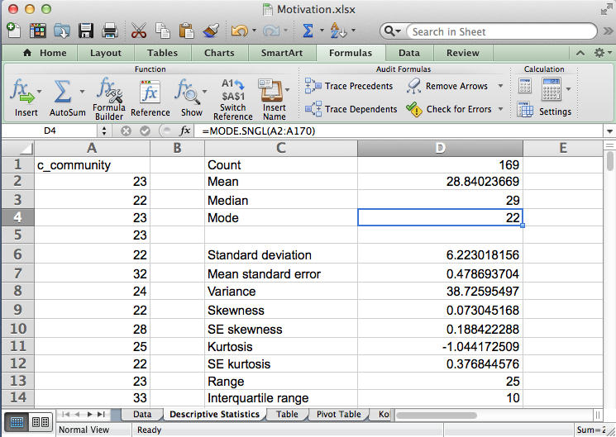
Excel displays the mode as 22.

Slide 21
Measures of Dispersion
Designed to give information concerning the amount of dispersion of scores about a central value.
Researchers typically report the best measures of central tendency and dispersion for each variable. The best measure to report varies based on the shape of a variable’s distribution and scale of measurement.
  Interval/ratio data – standard deviation, variance, and range can be calculated and reported, as appropriate.
  Ordinal/nominal data - range can and should be reported; use of the standard deviation or variance is wrong.
 | Appropriate Measures of Dispersion
Nominal data | Range
Ordinal data | Range
Interval data | Standard Deviation, Variance, Range
Ratio data | Standard Deviation, Variance, Range

Slide 22
Open the dataset Motivation.xlsx.
Click the worksheet Descriptive Statistics tab (at the bottom of the worksheet).
File available at http://www.watertreepress.com/stats
TASK
Calculate the standard deviation, variance, and range of the classroom community (c_community) variable.

Slide 23
Standard Deviation (S, SD, σ)
Indicates how much scores deviate below and above the mean
For normally distributed data
  68.2% of the distribution falls within ± 1 SD of the mean
  95.4% of the distribution falls within ± 2 SD of the mean
  99.6%of the distribution falls within ± 3 SD of the mean
Formulas
(Note: dividing by (N – 1) rather than N for sample standard deviation results in an unbiased estimate of population standard deviation.)
Excel functions:
STDEV.S(number1,number2,...). Returns the unbiased estimate of population standard deviation, where numbers represent the range of numbers
STDEV.P (number1,number2,...). Returns the population standard deviation, where numbers represent the range of numbers

Slide 24
Example of Standard Deviation
For an unbiased estimate of the population standard deviation, N – 1 is used in the formula in place of N, otherwise the formula will underestimate the population sum of squares.

Slide 25
TASK
Enter the following formula in cell D6 to calculate the standard deviation for c_community:
=STDEV.P(A2:A170)

Slide 26
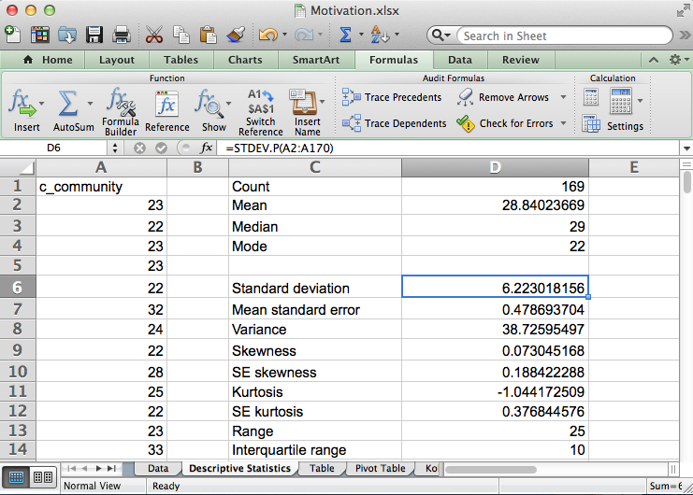
Excel displays the SD as 6.22. This sample statistic is typically reported as SD = 6.22 in the results section of a research paper, as appropriate.
Note: this measure is not an unbiased estimate of the population SD. If an unbiased estimate of the population SD is desired use the formula =STDEV.S(A2:A170).

Slide 27
Variance (S², σ²)
Variance is the average of each score’s squared difference from the mean.
Not a very useful as a descriptive statistic. Important value used in certain techniques (e.g., the analysis of variance or ANOVA)
The formula for the population and sample variances are given below.
(Note: dividing by (N – 1) rather than N for sample variance results in an unbiased estimate of population variance.)
Excel functions:
VAR.S(number1,number2,...). Returns the unbiased estimate of population variance, with numbers representing the range of numbers.
VAR.P (number1,number2,...). Returns the population variance, with numbers representing the range of numbers.

Slide 28
Example of Variance
For an unbiased estimate of the population standard deviation, N – 1 is used in the formula in place of N, otherwise the formula will underestimate the population sum of squares.

Slide 29
TASK
Enter the following formula in cell D8 to calculate the variance of variable c_community:
=VAR.P(A2:A170)

Slide 30
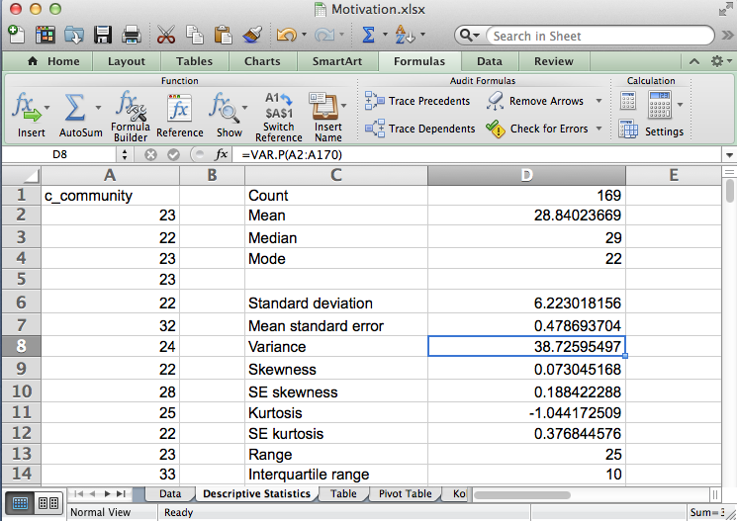
Excel displays the variance as 38.73.
Note: this measure is not an unbiased estimate of the population variance. If an unbiased estimate of the population variance is desired use the formula =VAR.S(A2:A170).

Slide 31
Range
The range of a distribution is calculated by subtracting the minimum score from the maximum score.
The range is not very stable (reliable) because it is based on only two scores. Consequently, outliers have a significant effect on the range of a variable.
Excel formula:
=MAX(number1,number2,...)–MIN(number1,number2,...)
Note: MAX(number1,number2,...) returns the maximum value in a set of numbers and MIN(number1,number2,...) returns the minimum value in a set of numbers.

Slide 32
Example of Range
Range = maximum value – minimum value = 8 – 5 = 3

Slide 33
TASK
Enter the following formula in cell D13 to calculate the range of variable c_community:
=MAX(A2:A170)-MIN(A2:A170)

Slide 34
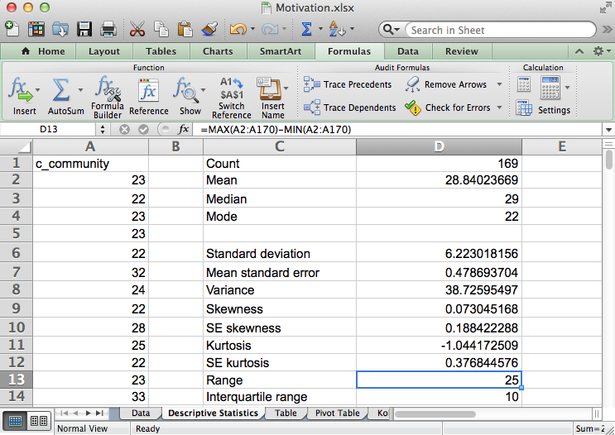
Excel displays the range as 25.

Slide 35
Measures of Relative Position
Measures of relative position indicate how high or low a score is in relation to other scores in a distribution
A percentile (P) is a measure that tells one the percent of the total frequency that scored below that measure
  The kth percentile (P_{k}) of a set of data is a value such that k percent of the observations are less than or equal to the value
A quartile (Q) divides the data into four equal parts based on their statistical ranks and position from the bottom
  Q₁ has 25% of the data below it
  Q₂ (median) has 50% of the data below it
  Q₃ has 75% of the data below it
  Interquartile range (IQR) = Q₃ – Q₁
Percentiles and quartiles are cutoff scores and not ranges of values

Slide 36
Measures of Relative Position
Excel functions:
PERCENTILE.INC(array,k). Returns the kth percentile in a range of numbers.
QUARTILE.INC(array,quart). Returns the specified quartile, in a range of numbers.
Note: k = the percentile value in the range 0 to 1, inclusive; quart = 0 returns the minimum value, quart = 1 returns Q₁, quart = 2 returns Q₂ (median), quart = 3 returns Q₃, quart = 4 returns the maximum value.

Slide 37
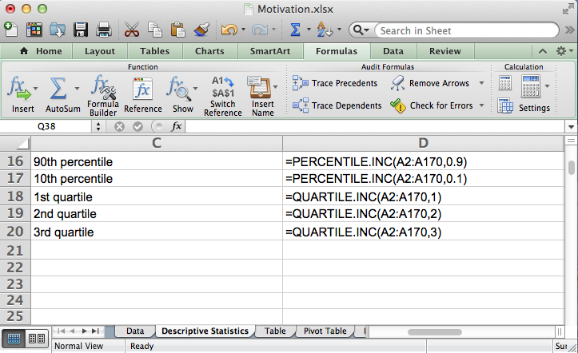
TASK
Enter the formulas in cells D16:D20 as shown on the worksheet to calculate P₉₀, P₁₀, Q₁, Q₂, and Q₃.

Slide 38
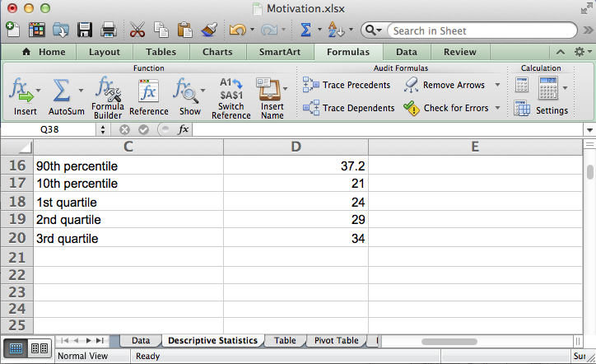
Excel displays percentiles and quartiles.

Slide 39
Descriptive Statistics
End of Presentation

